Slide 1



MTN-025 (HOPE) Data Management Training: Enrollment Visit
Statistical Center for HIV/AIDS Research & Prevention (SCHARP)
Fred Hutchinson Cancer Research Center

Slide 2
Enrollment CRFs
Enrollment
Pregnancy Test Result
Family Planning Log
Concomitant Medications Y/N
Specimen Storage
ACASI Tracking
Ring Collection and Insertion
Vaginal Ring Tracking Log, if applicable
Baseline Behavior Assessment
Baseline Vaginal Practices Assessment
Additional Study Procedures
Enrollment QA/QC
Notes:
Just a reminder that if a participant is eligible, the ECI CRF and other Screening Visit forms will be submitted into Medidata Rave at this visit for those participants who enroll into the HOPE study.

Slide 3
Enrollment
Captures Screening/Enrollment Informed Consent Date
Item 3: Mark ‘pending’ box and update later if post-study storage consent not provided at EV; change response as needed if ppt changes her mind
HIV item used to document in the database the ppt’s eligibility
Date of Enrollment
Notes:
The Enrollment CRF captures the dates of the Screening and Enrollment Informed Consent as a way for SCHARP to double-check that the participant was enrolled within the screening window of 56 days.
If storage consent is not provided to the participant at the Enrollment Visit, you may mark the pending box and update as needed during the study if the participant changes her mind. This item is required to be marked with ‘yes’ or ‘no’ by the end of the participant’s study participation.
The HIV items on this form as used to double-check that the participant is eligible as these results are not collected and captured on the HIV Results CRF. We expect this item to be marked, ‘no’, that the participant is not HIV-infected at Enrollment.

Slide 4
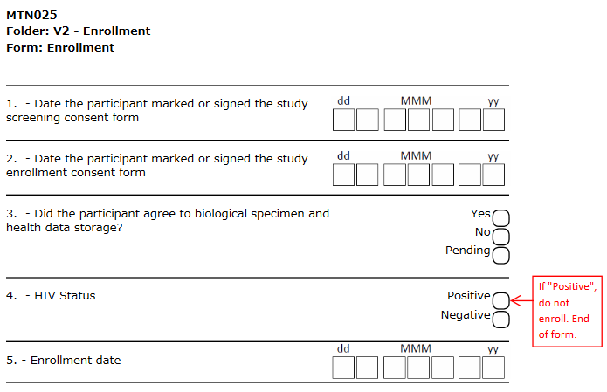
Enrollment
Notes:
The Enrollment CRF captures the dates of the Screening and Enrollment Informed Consent as a way for SCHARP to double-check that the participant was enrolled within the screening window of 56 days.
If storage consent is not provided to the participant at the Enrollment Visit, you may mark the pending box and update as needed during the study if the participant changes her mind. This item is required to be marked with ‘yes’ or ‘no’ by the end of the participant’s study participation.
The HIV items on this form as used to double-check that the participant is eligible as these results are not collected and captured on the HIV Results CRF. We expect this item to be marked, ‘no’, that the participant is not HIV-infected at Enrollment.

Slide 5
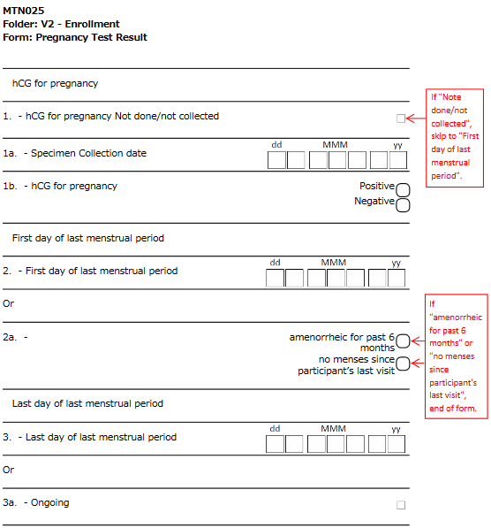
Pregnancy Test Result

Slide 6
Family Planning Log
Complete based on participant self-report
Enter all methods the participant is currently using; do not include methods she is planning to use
Record date the participant starting using that particular method
  Ensure medications recorded on Con Meds also (dates of use may differ)
Expect ‘ongoing’ to be selected at Enrollment for item date regimen stopped
If the participant stops using that particular regimen, update with the date regimen stopped
Update as needed during follow-up
Additional items at Enrollment Only
  If family planning method is same method at her last visit in ASPIRE
  If not the same method, the reason for changing or stopping
Notes:
The Family Planning Log is based on participant self-report and is not interviewer-administered and is not translated.
Mark all methods that the participant is currently using and do not include any methods that the participant is planning to use.
For hormonal methods, record the date that the participant starting using that particular method. For example, if a participant reports that she started using Depo in October 2012, date started using is October, 2012 for the date regimen started (month and year required). Record any hormonal methods used on the Concomitant Medications Log as well using the trade name of the contraceptive if possible (Con Meds records each individual method; this captures regimen). Note that overall regimen dates of any contraceptive use should be recorded on the FP CRF, however, each administration of an injectable or provision of an OCP pill pack should be provided as separate entries on the con meds log.

Slide 7
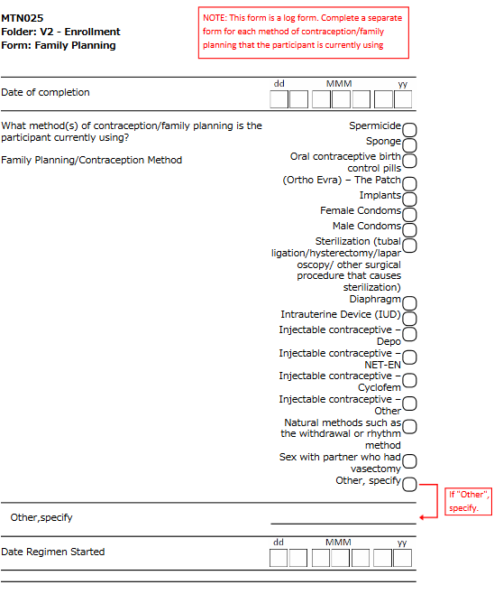
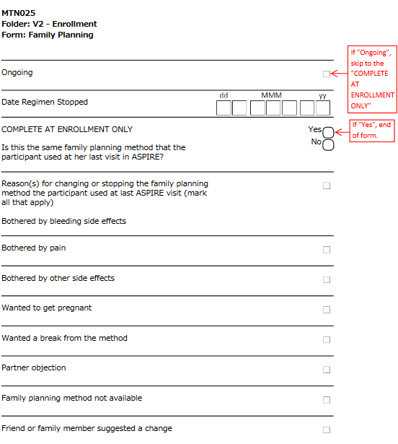
Family Planning Log
Notes:
The Family Planning Log is based on participant self-report and is not interviewer-administered and is not translated.
Mark all methods that the participant is currently using and do not include any methods that the participant is planning to use.
For hormonal methods, record the date that the participant starting using that particular method. For example, if a participant reports that she started using Depo in October 2010, date started using is October, 2010 for the date regimen started (month and year required). Records any hormonal methods used on the Concomitant Medications Log as well using the trade name of the contraceptive if possible (Con Meds records each individual method; this captures regimen). Note that overall regimen dates of any contraceptive use should be recorded on the FP CRF, however, each administration of an injectable or provision of an OCP pill pack should be provided as separate entries on the con meds log.

Slide 8
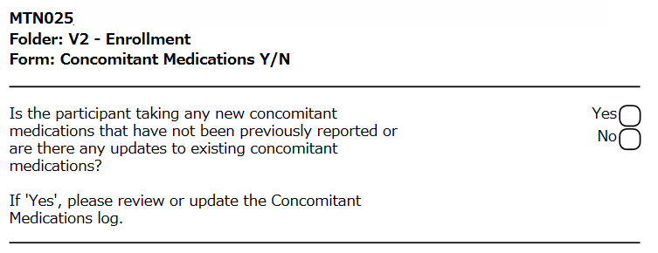
Concomitant Medications Y/N
Notes:
There will be a prompt question asking if any Con Meds were taken and this will be asked at every study visit. Additional entries can be added in the Con Meds form within the Ongoing Logs folder. To add additional con meds, selecting “Add a new Log line” will open up a new page to complete the concomitant medication information.

Slide 9
Specimen Storage
Documents collection and storage of:
  Hair specimens for PK
    Reason if hair collection not done
  Self-collected vaginal fluid swab
    Blood visible on swab? Used to inform swab analyses done at Laboratory Center
    Documents if used ring in place at time of swab collection
  Plasma storage
Enter specimens as “stored” if collected and sent for storage; update if you find out later that specimens were not stored
Notes:
The plasma storage item on the SS will document the collection of the archive plasma at Enrollment as well as the routine plasma stored for PK during follow-up.
At the Enrollment Visit, we would expect this to be "no – ring not in place at the start of the visit" since the swab should be taken prior to ring insertion at enrollment.

Slide 10
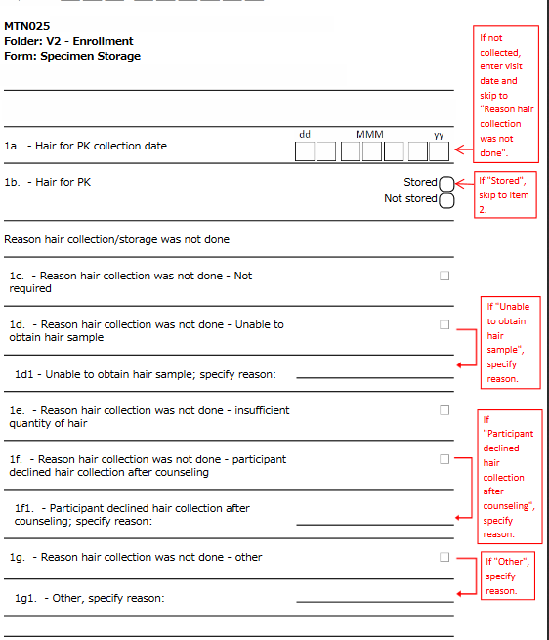
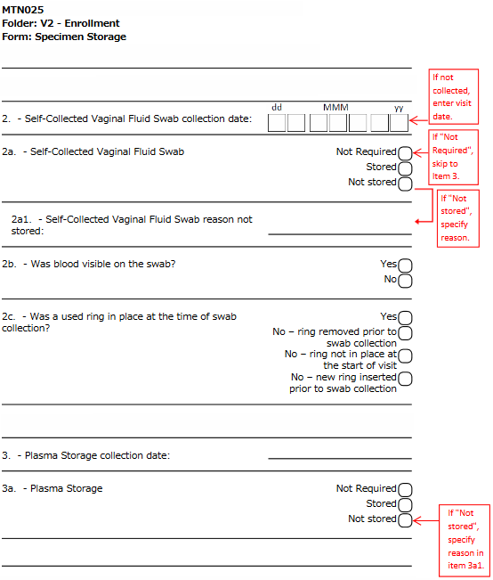
Specimen Storage
Notes:
The plasma storage item on the SS will document the collection of the archive plasma at Enrollment as well as the routine plasma stored for PK during follow-up.
At the Enrollment Visit, we would expect this to be "no – ring not in place at the start of the visit" since the swab should be taken prior to ring insertion at enrollment.

Slide 11
ACASI Tracking
Captures whether ACASI questionnaire was completed (at Baseline) regardless of whether or not ACASI was actually done
Used to document whether anything unusual about ACASI administration, for example:
  Participant refused to do ACASI
  Wrong questionnaire chosen (i.e. M3 chosen instead of baseline)
  Interrupted sessions, resulting in two records for given visit (one incomplete and one complete)
  Any technical issues
Notes:
This form is required anytime that an ACASI questionnaire is required. For Enrollment, we expect that the Baseline questionnaire to be selected.

Slide 12
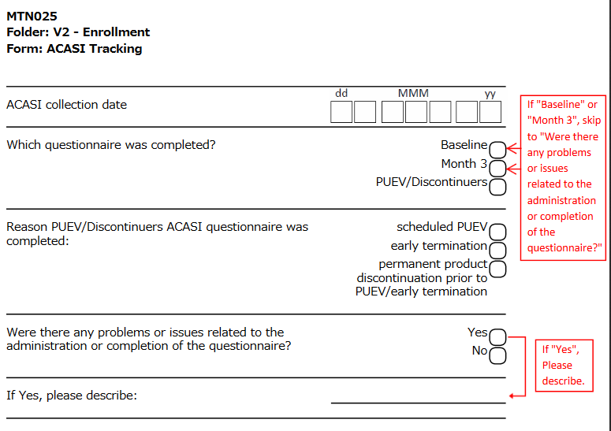
ACASI Tracking
Notes:
This form is required anytime that an ACASI questionnaire is required. For Enrollment, we expect that the Baseline questionnaire to be selected.

Slide 13
Ring Collection and Insertion
Do not need to complete items specific to Ring Collection at Enrollment Visit
Documents ring choice and ring provision at the clinic
Ring Choice
  Captures if participant chose to use a new ring at this visit. If not, captures reasons why.
Ring Provision
  Captures whether ring was provided/inserted at this visit or reasons why if not provided/inserted
  Ring Code of ring inserted at the end of visit
Notes:
This form collects information on ring collection, ring provision, and ring choice.

Slide 14
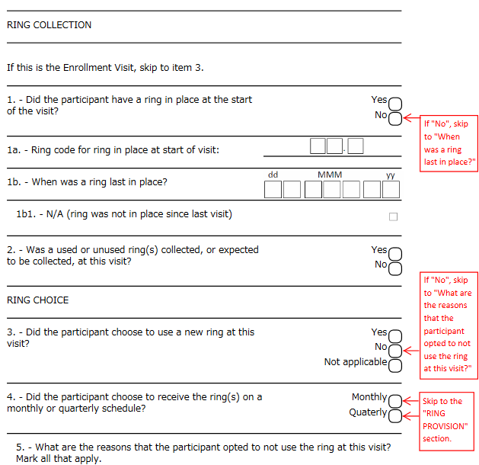
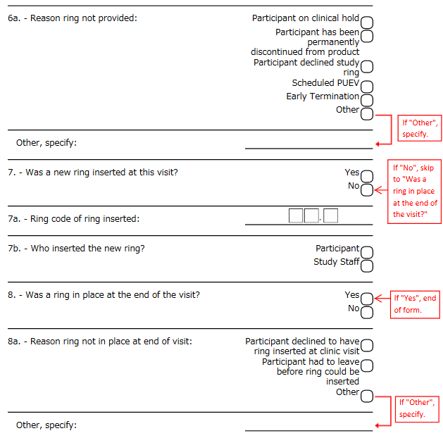
Ring Collection and Insertion

Slide 15
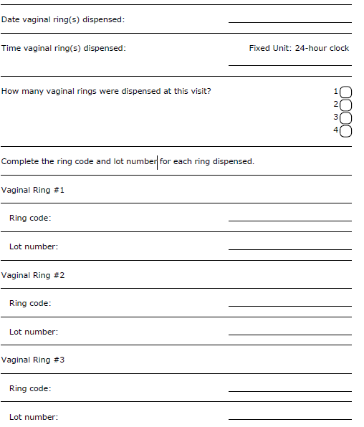
Pharmacy Ring Dispensation
Notes:
This form is to be completed by pharmacy staff only. This form will be covered in the Pharmacy Training.

Slide 16
Vaginal Ring Tracking Log
New CRF for HOPE
Ring Provided portion:
  Captures ring code, date and visit of ring provision
Ring Returned portion:
  Captures date and visit when ring returned, ring storage, and
  Includes two questions on ring use per participant report for all stored rings
  Leave this section of the log form blank until ring returned or outcome of ring is known
Notes:
If a new ring is provided or if a used or unused ring is returned at a scheduled or interim visit, in addition to completing the Ring Collection and Insertion CRF, an entry on the Vaginal Ring Tracking Log should be completed. This form is new to HOPE and was created to track the order in which each ring was used by the participant.
The items in the Ring Provided portion of the log form should be completed for each ring that is dispensed. For each ring provided, enter in the ring code as specified on the ring bag provided with the ring by the study pharmacy and provide the date when the ring was provided to the participant. Leave the remaining items on the log form blank until the ring is returned.
When the ring is expected to be returned to the clinic, update the Ring Returned portion of the log CRF with the date and visit that the ring is returned. If the ring was not returned when expected, you will be asked to specify the reason that the ring was not returned. Should the participant return the ring at a later date, the form should be updated to reflect the date and visit at which the ring was returned.

Slide 17
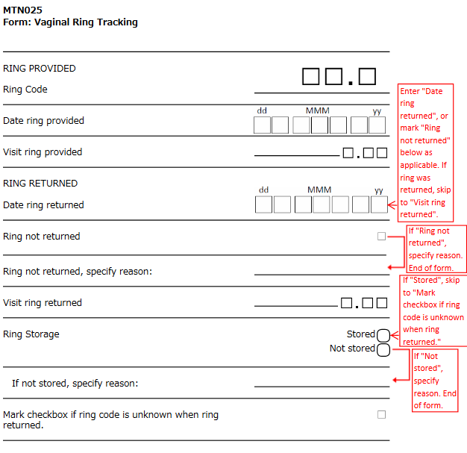
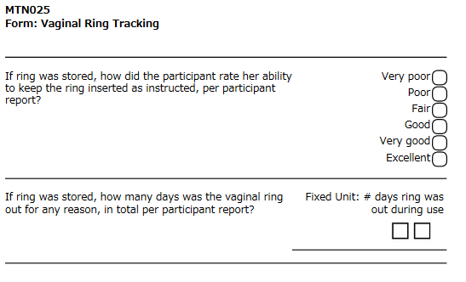
Vaginal Ring Tracking Log
Notes:
When a ring is returned to the clinic and it is not clear what the associated ring code for that ring should be, mark the checkbox indicating this on the tracking log.
Please note that the participant reported questions on the use of each ring should not be reconciled with adherence counseling sessions with the participant or any other source documentation. If the participant cannot remember exactly how many days the ring a particular ring was out, ask the participant to provide her best estimate.

Slide 18
Baseline Behavior Assessment
Interviewer-administered, translated, read aloud word-for-word
Complete all items; provide clarity as needed
Collects info on primary sex partner: his HIV status, use of ARVs, circumcision status, study/ring disclosure status, clinic attendance
  partner’s ARV use is asked regardless of whether partner HIV status is known

Slide 19
Baseline Behavior Assessment - continued
Questions regarding sexual behavior
  Other sex partners, frequency of vaginal sex (past 3 months, 7 days), anal sex, condom use
Questions about the ring
  How much protection participant feels Dapivirine ring can provide against HIV
Specific yes/no questions why participant may choose to participate in HOPE

Slide 20
Baseline Vaginal Practices Assessment
Interviewer-administered, translated
Captures use of products that may alter vaginal/intravaginal environment
Collects info on vaginal items used during menses and in general
These same questions will be asked at PUEV/early termination

Slide 21
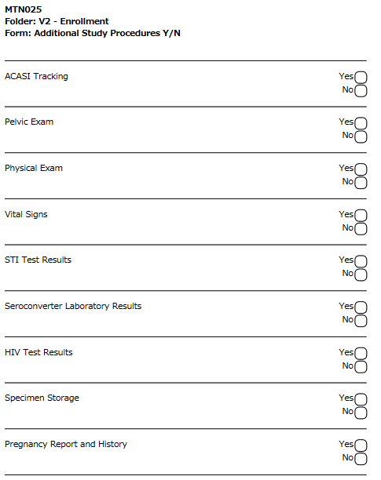
Additional Study Procedures
Complete this form if additional CRFs completed at this visit, if indicated (i.e. Physical Exam)
  Select ‘yes’ for each form and this will add to the visit folder
Notes:
If there are any additional forms that are completed if indicated (for example, a Physical Exam was conducted), then each applicable form can be checked as “Yes” and this will add the form to the corresponding visit folder.

Slide 22
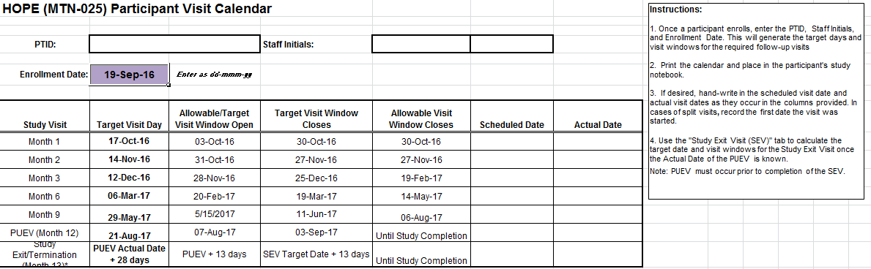
Visit Calendar Tool
Notes:
This Visit Calendar Tool is posted on the MTN 025 website and can be used to create a participant study visit schedule/calendar for participants who enroll into MTN-025. There are fields to enter the PTID, staff initials, and date. The Enrollment Date can be inputted into the tool and the target dates and visit windows are programmed into the tool to create a visit schedule for the participant for the remaining follow-up visits. This visit schedule can be placed in the participant’s binder.
The scheduled visit date and actual visit date can be entered/written in as they occur in the columns provided. In cases of split visits, the first date the visit started should be recorded.

Slide 23
Enrollment QA/QC
During visit:
  Review the 2 interviewer-administered CRFs to ensure completeness and skip patterns followed
  Review visit checklist to make sure all required procedures completed, including plasma archive collection
If Enrolled
  Submit all appropriate SV and EV forms to SCHARP via Medidata Rave
  Submit appropriate lab results/pelvic exam CRFs in cases where repeat results are available

